Slide 1
Medians and Order Statistics
By
Dr. Subhashis Majumder
Professor and HoD, CSE,
Dean UG Programme, HIT

Slide 2
What is ith order statistic?
It is the ith smallest element in a set of n elements (which are comparable)
Minimum – 1st order statistic
Maximum – nth order statistic
Median – half way element
Median is unique when n is odd, i = (n + 1)/2
Two medians exist when n is even, i = n/2 and i = (n)/2 + 1
Normally median refers to the lower median irrespective of parity, where i = L (n + 1)/2 ˩

Slide 3
Selection Problem
Statement –
Given a set A of n (distinct) numbers and i, 1 ≤ i ≤ n.
Return x ϵ A, ϶ it is exactly larger than i – 1 other elements of A.
Naïve solution – Sort in O(n lg n) time and then return the ith element.
However, better solutions exist.

Slide 4
Finding the minimum (or maximum) of n elements
Comparisons required is n – 1.
Minimum(A)
min ← A[1]
for i ← 2 to length(A)
do if min > A[i]
then min ← A[i]
return min

Slide 5
Finding Minimum & Maximum simultaneously
number of comparisons required ≤ 2(n - 1)
Is it obvious? Will you call it an upper bound?
Can you improve the bound further, or rather can you lower the upper bound to make more tight?

Slide 6
Better Strategy
Suppose min is your current minimum and max is your current maximum
Take a pair of elements from the input set and compare with each other.
Now compare the smaller one with min to decide the new value of min
Similarly compare the larger one with max ….
So need 3 comparisons for every 2 elements

Slide 7
Details
Case 1 – n is odd
Assign the 1st element to both min and max
Then we need 3 L n/2 ˩ comparisons to process the rest of the elements
Case 2 – n is even
Compare the first pair and assign the min & max
Then perform 3 (n – 2)/2 comparisons to process the rest
Total is 1 + 3 n/2 – 3 = 3 n/2 – 2
So we can say total number of comparisons in either case is at most 3 L n/2 ˩

Slide 8
Find 2nd smallest element
Naïve solution: (n – 1) + (n – 2) comparisons
Show that the 2nd smallest of n elements can be found with n + Γ lgn ˥ - 2 comparisons in the worst-case.
For determining the smallest element we obviosly need n – 1 comparisons
Consider this as a knock-out tournament of some game, where the smaller element always wins.
Question – Who are the possible candidates for becoming the runner-up (i.e. 2nd smallest)?
Hint – The runner-up can lose only to the winner

Slide 9
Answer – The candidates are those elements who lost a direct game against the winner.
2nd question – What is the number of such candidates?

Slide 10
Answer – Γ lg n˥ direct losers in the worst-case
In the figure, n = 10, Γ lg n˥ = 4.
Now, to determine the winner out of them will take Γ lg n˥ - 1 comparisons.
Hence total number of comparisons = (n – 1) + (Γ lg n˥ - 1) = n + Γ lg n˥ - 2

Slide 11
Lower Bound Result
Problem – Show that Γ 3n/2˥ - 2 comparisons are necessary for finding the minimum and maximum of n numbers in the worst-case.
Answer –
Observe that initially all the n elements are in contention each for the maximum or minimum position and we have to eliminate n – 1 elements from each of these two knock-out tournaments.
Now a comparison between two ‘fresh’ elements (which did not take part in any such comparison before) will eliminate 1 element each from the 2 tournaments.
However if any of the elements is not fresh, then a comparison either eliminates one element from the max-tournament or one from the min-tournament.

Slide 12
Note that if you are lucky, you may strike two elements out – eg. If a fresh element is found smaller than a used element which is already out of the max-tournament
However if the fresh element turns out to be greater than the used element in the above comparison, then only job done is – fresh element out of the min-tournament
If both elements are used, then either both of them will be in max-tour. or both in min-tour. and hence only one will be eliminated
Hence in the worst-case if both elements are not fresh, number of eliminations will be only 1.

Slide 13
Now, maximum number of comparisons possible where both elements are fresh is Ln/2˩, which will contribute to exactly 2 Ln/2˩ eliminations
Hence number of eliminations still required is 2(n – 1) - 2 Ln/2˩
Hence in the worst-case number of comparisons that is necessary to finish the job is Ln/2˩ + 2(n – 1) - 2 Ln/2˩ = 2(n - Ln/2˩) + Ln/2˩ - 2 = 2 Γn/2˥ + Ln/2˩ - 2 = n + Γn/2˥ - 2 = Γ3n/2˥ - 2 (Since Ln/2˩ + Γn/2˥ = n)

Slide 14
Selection in Expected Linear Time
Randomized_Select works on only one side of the partition. It returns the ith smallest element from the array A[p…r]
Procedure Randomized_Select(A, p, r, i)
if p = r
then return A[p]
q ← Randomized_Partition(A, p, r)
K ← q – p + 1
if i = k // lucky – pivot value is the answer
then return A[q]
elseif i < k
then return Randomized_Select(A, p, q - 1, i)
else
return Randomized_Select(A, q + 1, r, i - k)

Slide 15
Complexity Analysis
Time required by Randomized_Select on an input array of n elements is a random variable that we denote by T(n). Let us calculate an upper bound on E(T(n)).
Now, Randomized_Partition is equally likely to return any element as pivot. So, for each k, 1 ≤ k ≤ n, the subarray A[p…q] has k elements (≤ pivot) with probability 1/n.
For k = 1, 2, …, n, we define indicator random variables x_{k} , where x_{k} = 1 if the subarray A[p…q] has exactly k elements, so E(x_{k}) = 1/n

Slide 16
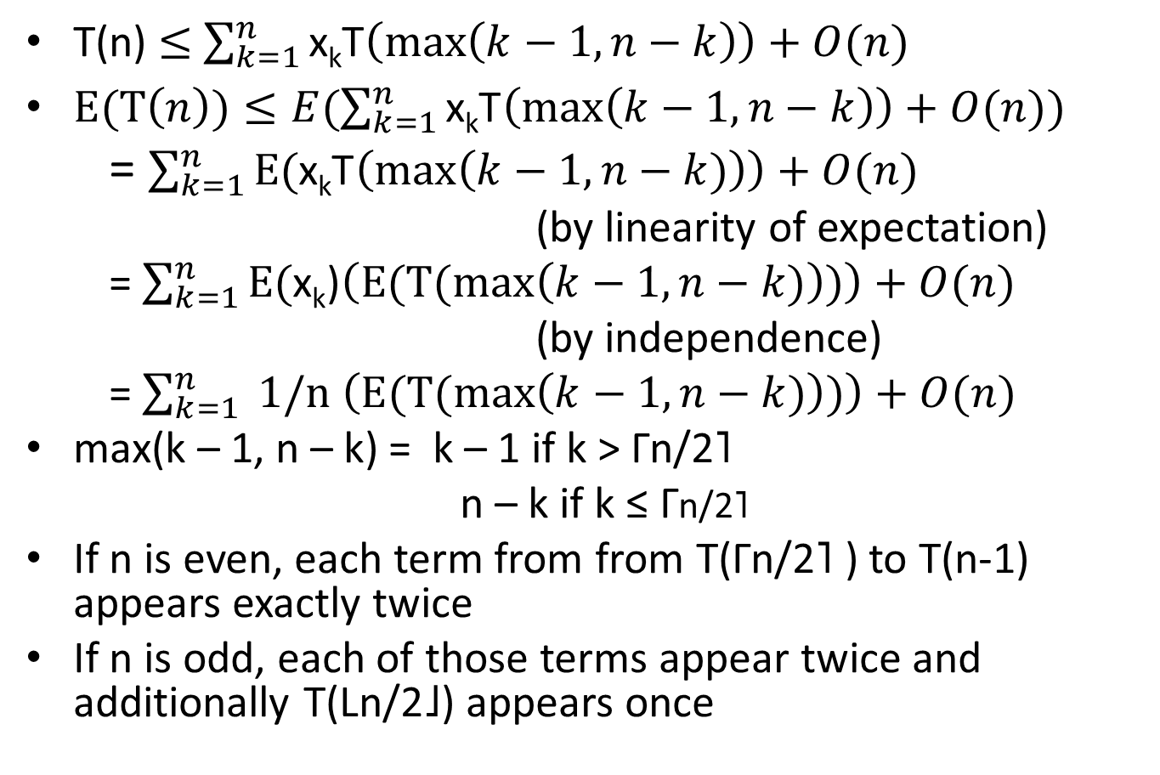
T(n) $≤$ $\sum_{k=1}^{n}{\text{x}\text{k}\text{T}\left(\max\left(k−1,n−k\right)\right)+O(n)}$
$E(T\left(n\right))≤E(\sum_{k=1}^{n}{\text{x}\text{k}\text{T}\left(\max\left(k−1,n−k\right)\right)+O(n))}$
= $\sum_{k=1}^{n}{\text{E}\text{(}\text{x}\text{k}\text{T}\left(\max\left(k−1,n−k)\right)\right)+O(n)}$
(by linearity of expectation)
= $\sum_{k=1}^{n}{\text{E}\text{(}\text{x}\text{k}\text{)}\left(E(T(max\left(k−1,n−k)\right))\right)+O(n)}$
(by independence)
= $\sum_{k=1}^{n}{\text{ 1/}\text{n} \left(E(T(max\left(k−1,n−k)\right))\right)+O(n)}$
max(k – 1, n – k) = k – 1 if k > Γn/2˥
n – k if k ≤ Γn/2˥
If n is even, each term from from T(Γn/2˥ ) to T(n-1) appears exactly twice
If n is odd, each of those terms appear twice and additionally T(Ln/2˩) appears once

Slide 17
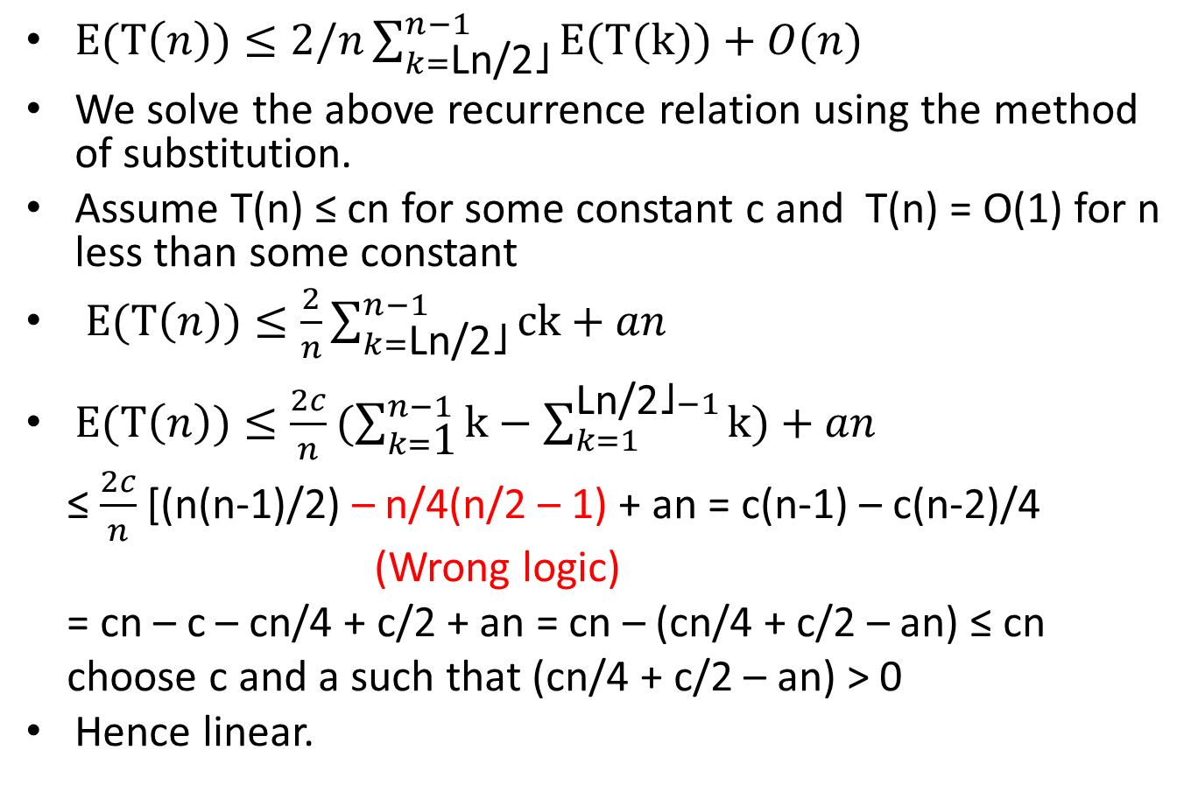
$E(T\left(n\right))≤2/n\sum_{k=\text{Ln}\text{/2˩}}^{n−1}{\text{E}\text{(}\text{T}\text{(}\text{k}\text{))}+O(n)}$
We solve the above recurrence relation using the method of substitution.
Assume T(n) ≤ cn for some constant c and T(n) = O(1) for n less than some constant
$E(T\left(n\right))≤\frac{2}{n}\sum_{k=\text{Ln}\text{/2˩}}^{n−1}{\text{ck}+an}$
$E(T\left(n\right))≤\frac{2c}{n}(\sum_{k=\text{1}}^{n−1}{\text{k}−\sum_{k=1}^{\text{Ln}\text{/2˩}−1}{\text{k}})+an}$
≤ $\frac{2c}{n}$ [(n(n-1)/2) – n/4(n/2 – 1) + an = c(n-1) – c(n-2)/4
(Wrong logic)
= cn – c – cn/4 + c/2 + an = cn – (cn/4 + c/2 – an) ≤ cn
choose c and a such that (cn/4 + c/2 – an) > 0
Hence linear.

Slide 18
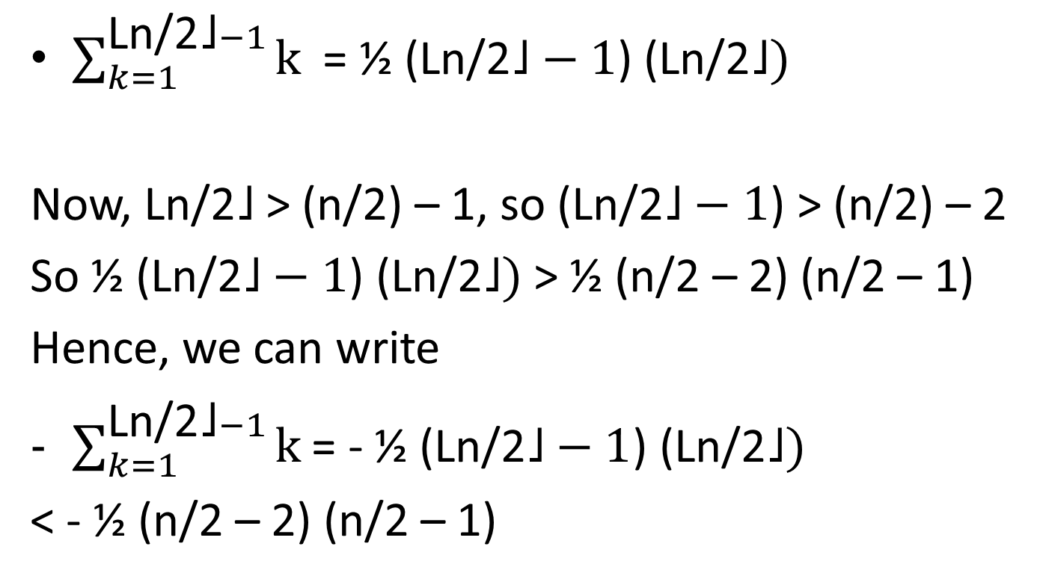
Correct Analysis
$\sum_{k=1}^{\text{Ln}\text{/2˩}−1}{\text{k}}$ = ½ ($\text{Ln}\text{/2˩}−1$) ($\text{Ln}\text{/2˩})$
Now, $\text{Ln}\text{/2˩}$ > (n/2) – 1, so ($\text{Ln}\text{/2˩}−1$) > (n/2) – 2
So ½ ($\text{Ln}\text{/2˩}−1$) ($\text{Ln}\text{/2˩})$ > ½ (n/2 – 2) (n/2 – 1)
Hence, we can write
$\sum_{k=1}^{\text{Ln}\text{/2˩}−1}{\text{k}}$ = - ½ ($\text{Ln}\text{/2˩}−1$) ($\text{Ln}\text{/2˩})$
< - ½ (n/2 – 2) (n/2 – 1)

Slide 19
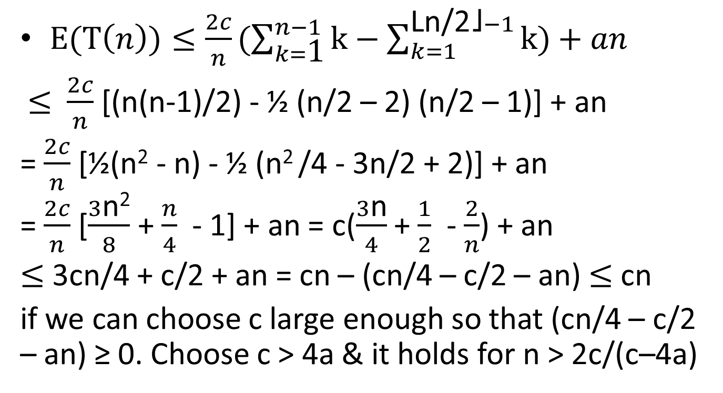
Selection of any order statistic (in particular median) is indeed linear
$E(T\left(n\right))≤\frac{2c}{n}(\sum_{k=\text{1}}^{n−1}{\text{k}−\sum_{k=1}^{\text{Ln}\text{/2˩}−1}{\text{k}})+an}$
$≤$ $\frac{2c}{n}$ [(n(n-1)/2) - ½ (n/2 – 2) (n/2 – 1)] + an
= $\frac{2c}{n}$ [½(n² - n) - ½ (n² /4 - 3n/2 + 2)] + an
= $\frac{2c}{n}$ [$\frac{3\text{n}\text{2}}{8}$ + $\frac{n}{4}$ - 1] + an = c($\frac{3\text{n}}{4}$ + $\frac{1}{2}$ - $\frac{2}{n}$) + an
$≤$ 3cn/4 + c/2 + an = cn – (cn/4 – c/2 – an) $≤$ cn
if we can choose c large enough so that (cn/4 – c/2 – an) ≥ 0. Choose c > 4a & it holds for n > 2c/(c–4a)

